Slide 1


Slide 2
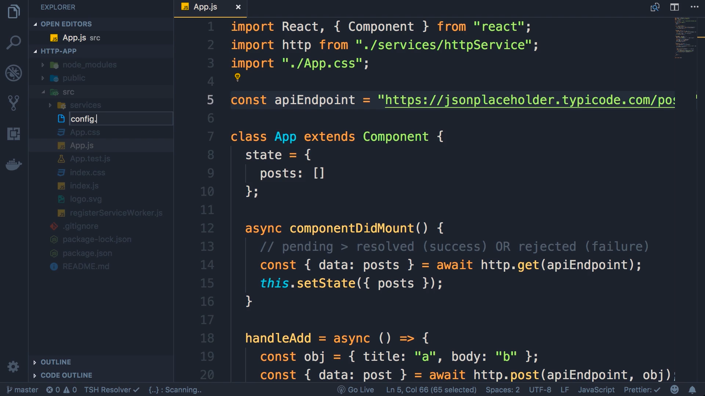
We want to movie this apiEndpoint and put it in a config file and resuse it. So create a new file config.json and we will move it here so that it can be resused

Slide 3
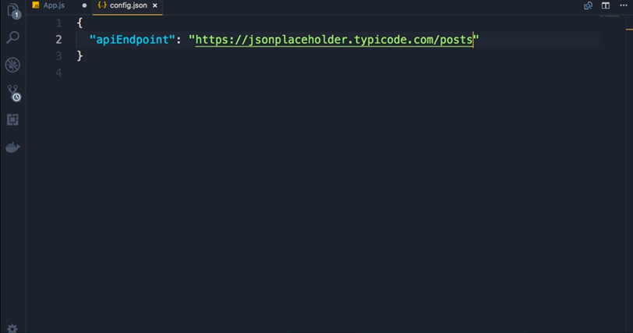

Slide 4
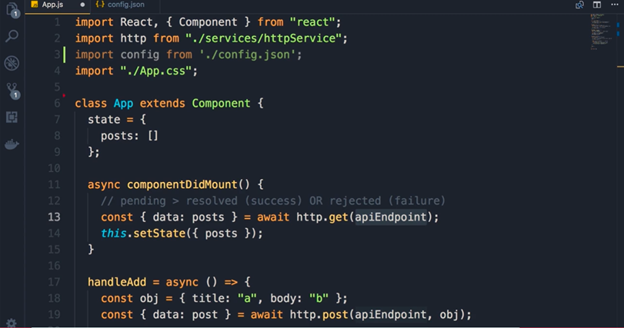
Import apiEndpoint (line 3) where ever we used apiEndpoint. Replace it with config.apiEndPoint

Slide 5
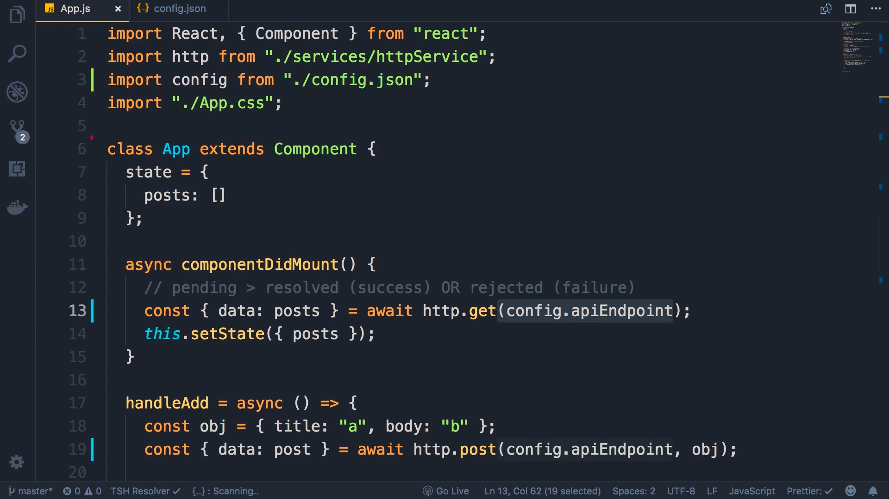
Line number 13 and 19 and 27

